Slide 1

1
IE Learning Platform
Learning from home with fun and ease

Slide 2
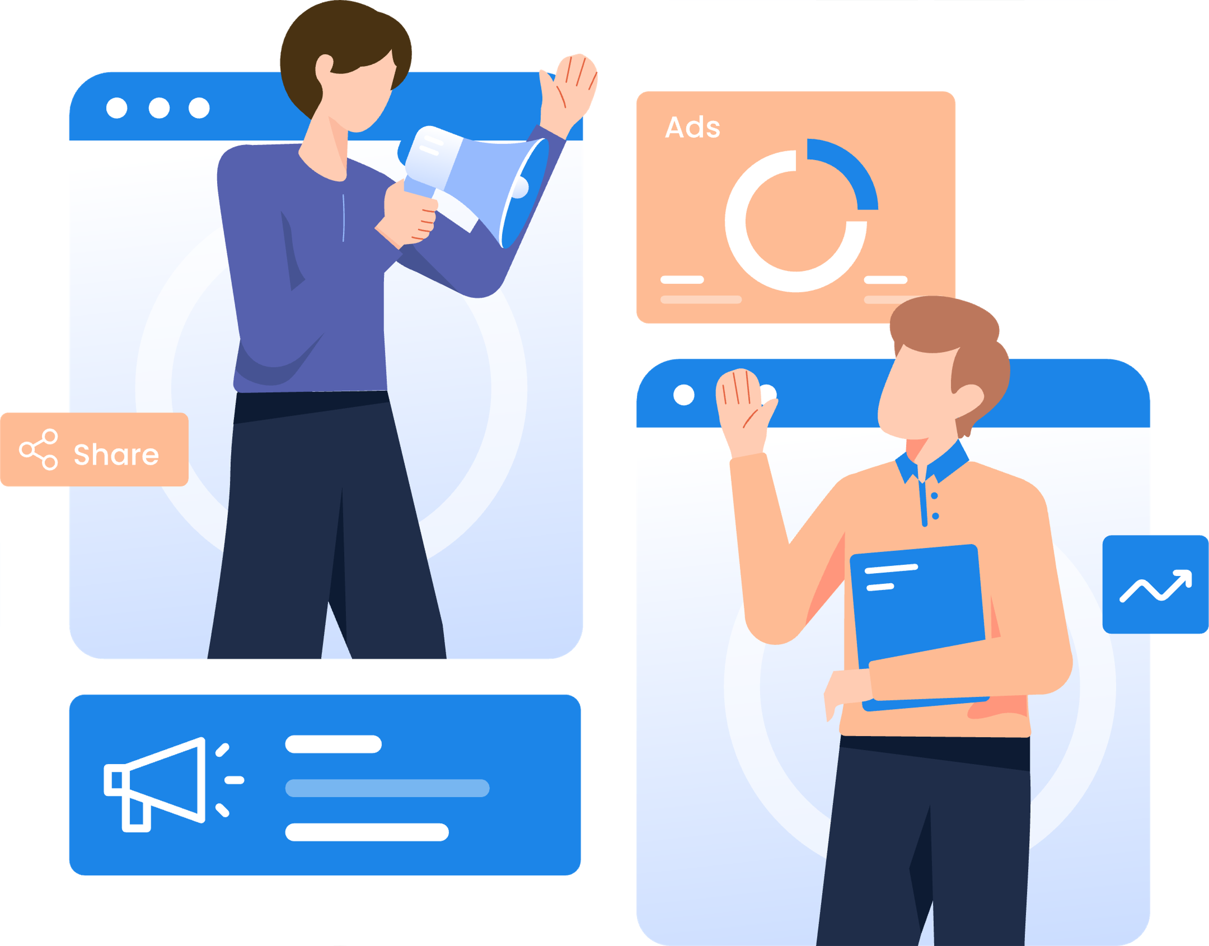
Members
2
Abdelrhman Karam Abdelrsoul (120220126)
Aliaa Maamoun Ibrahim (120220255)
Kamal Elsawah (120220005)
Marchellino Michel (120220317)
Fatma Mahmoud Abd Elrahman (120220355)
Ziad Mahmoud Hanafi (120220096)

Slide 3

Set up a workspace for studying
3
Transform learning from passive to interactive
Increase parental engagement (70% concern reduction)
Bridge tech gaps in national schools (only 25% use
interactive tools) Improve engagement for ages 6–15 through adaptive learning

Slide 4

Scope
4
• Gamified lessons (points, badges, leaderboards)
• VR STEM modules
• Parent portals (tracking + scheduling)
• AI-driven adaptive learning
• Cross-platform: Web, iOS, Android

Slide 5

StakeHolders
5
01
02
03
• Primary Users: Students (6–15)
• Secondary: Parents, Teachers, Admins
• Key Partners: Schools, UX, AI/ML Devs

Slide 6

6
User Requirement
• Students 6–11: Fun lessons, rewards (badges), challenges
• Students 12–15: Smart learning paths that adjust based on their quiz results
•Teachers: Create VR lessons, view heatmaps
• Admins: Monitor via dashboard

Slide 7
7
System Requirements
• Frontend: React.js, Flutter, Unity(vr)
• Backend Django REST, Redis(leaderboards), PostgreSQL (save data)
• AI ENGINE : TensorFlow Lite (on-device)
• VR: BUILD USING Three.js, <100ms latency
• Scale: supports (10,000 users),
.security ; AES-256

Slide 8
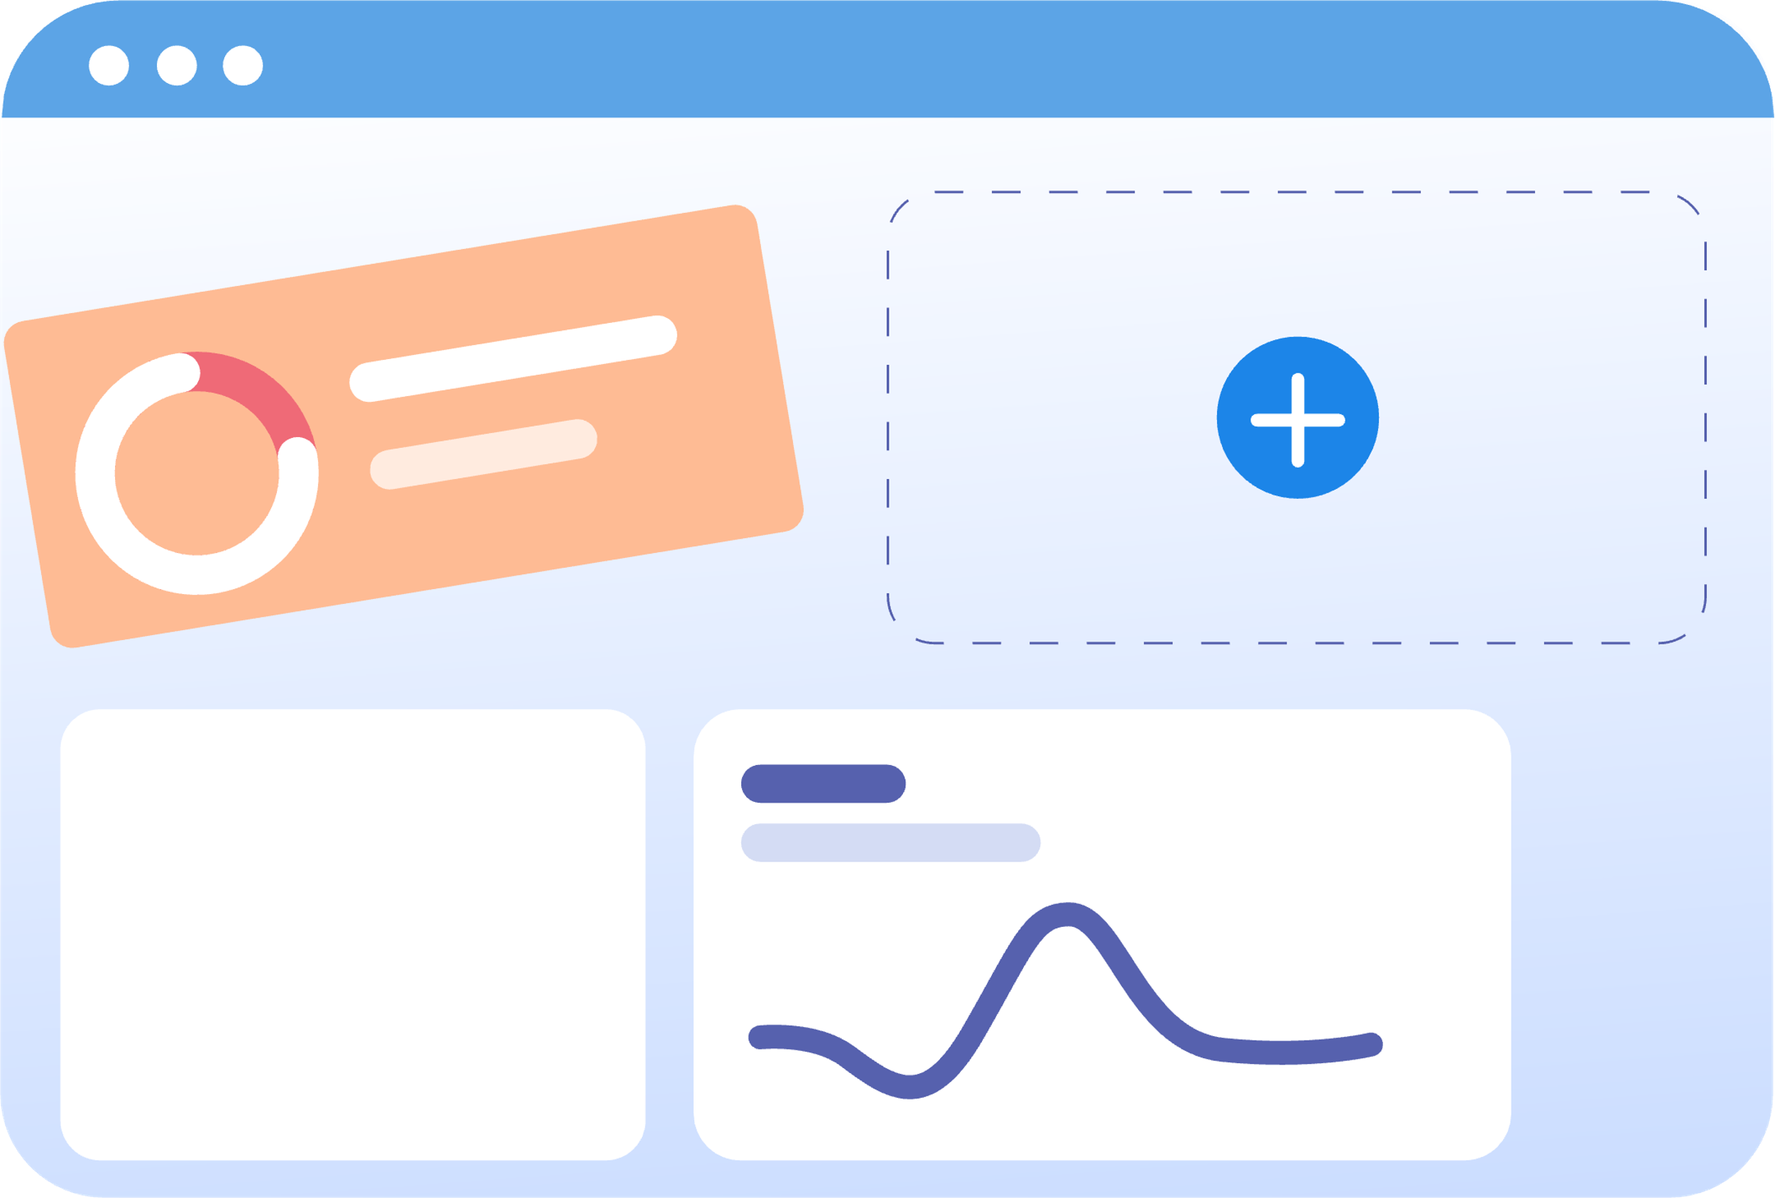
Functional Requirements
8
• Gamification: Points, badges(learning streaks), leaderboards
• VR Learning: #D simulations, collaboration
•
• Parent-Teacher Interface: Messaging, alerts, calendar

Slide 9

Non-Functional Requirements
9
• 60 FPS VR on mid-tier devices
• 99.9% uptime, auto-scaling
• Scalable for 500% growth

Slide 10
System Architecture
10
User Layer: Flutter (Mobile), React.js (Web), Three.js (VR)
Application Layer: Django Microservices, AI engine, Redis gamification, BunnyCDN (load fast)
Data Layer: PostgreSQL(users ), MongoDB(logs , analytics ), Amazon S3(store videos , images)

Slide 11
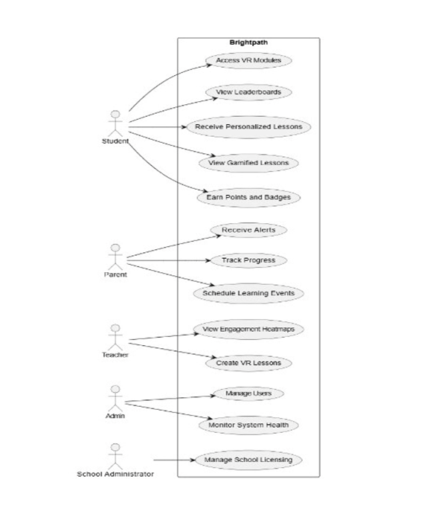
Diagrams

Slide 12
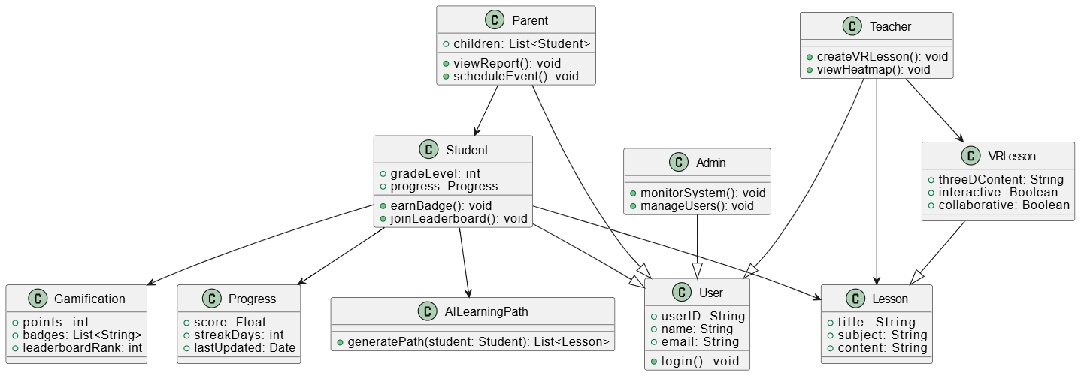

Diagrams

Slide 13
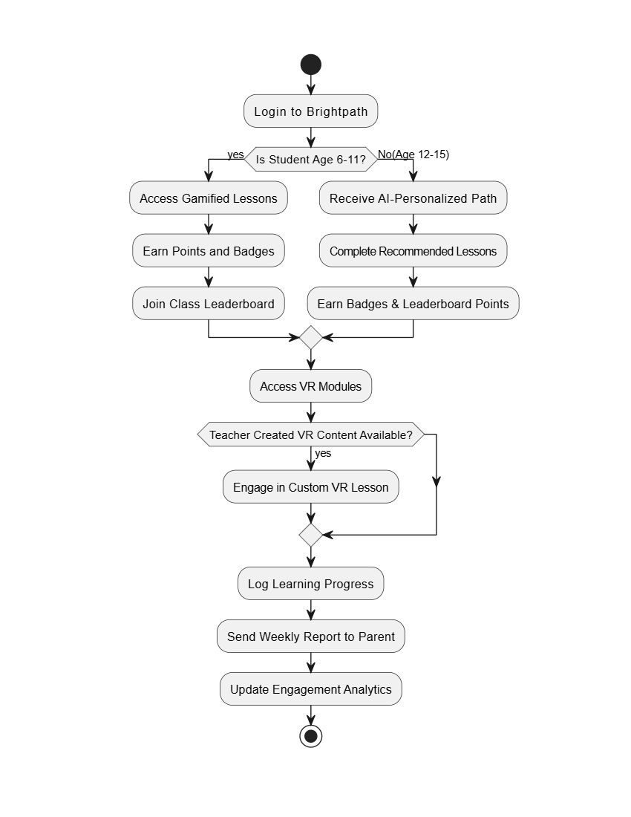

Diagrams

Slide 14



Thank you for your attention

